Slide 1
Lecture 3.1 – Graphics and Objects
M30299 Programming
School of Computing University of Portsmouth

Slide 2
Introduction to lecture
In this lecture we’ll take a look at how to incorporate some graphics into our programs.
We won’t be writing programs with complex graphical user interfaces.
Instead, we’ll write programs that will use some familiar concepts; e.g.
points, lines & shapes – circles, rectangles, polygons, …, and
basic interaction using mouse clicks and text
to learn more of the basics of programming.
We’ll introduce some object-oriented programming concepts (class, object, object construction, method, reference) as we go.

Slide 3
Using the graphix module
The graphics system we’ll use is not built in to the Python language.
Instead, it is a Python module (file) graphix.py, which should be downloaded from Moodle and placed in the same folder as your Python programs.
This module defines a number of new data types or classes.
We need to import any types we wish to use using an import statement:
>>> from graphix import Window, Point, Circle

Slide 4
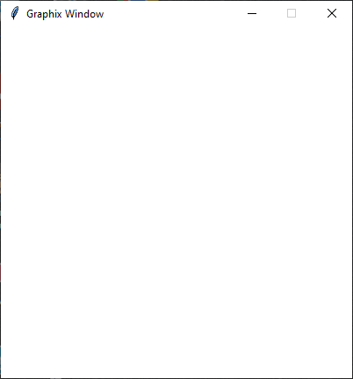
Creating a graphix window
We can now create a graphix window and assign it to a variable:
>>> win = Window()
This will give a window of dimensions 400 × 400 pixels (picture elements):
x
pixel (399, 0)
pixel (0, 0)
pixel (0, 399)
pixel (399, 399)
y

Slide 5
Graphical data
We now wish to draw points, lines, rectangles, circles, polygons, text labels, text entry boxes, etc. on the graphics window.
Like Window, all of these are classes defined in the graphix module; they are called:
Point
Line
Rectangle
Circle
Polygon
Text
Entry

Slide 6
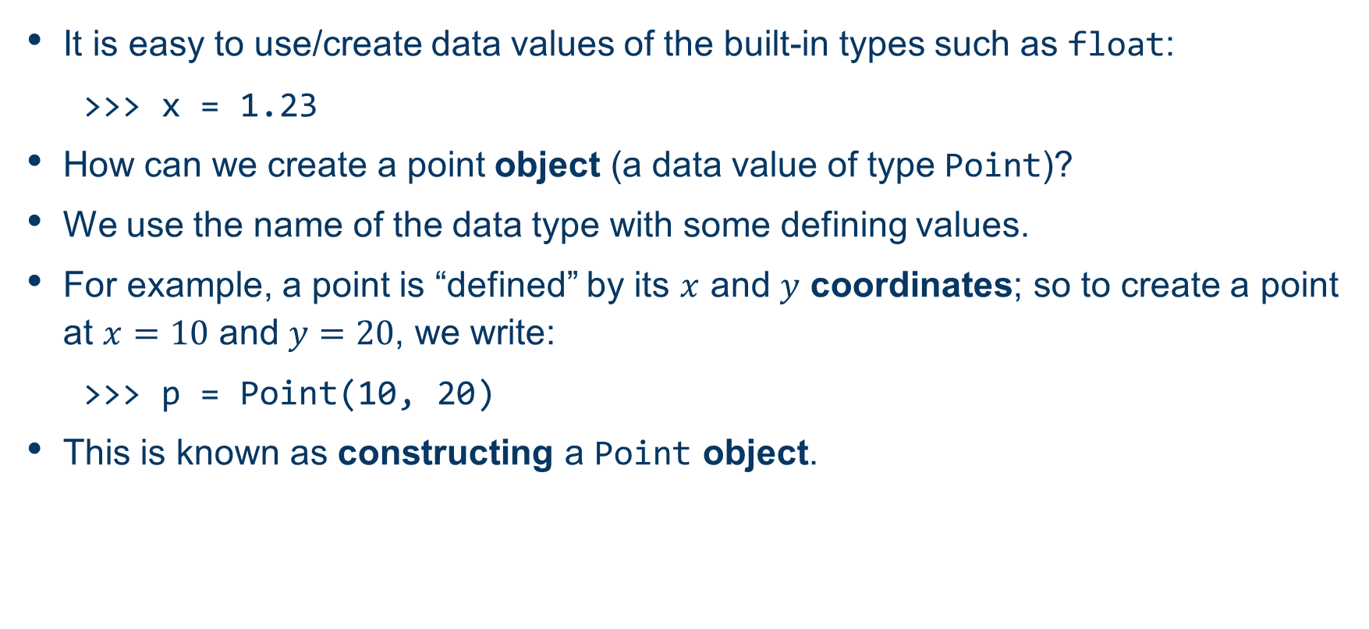
Creating graphical objects

Slide 7
Accessing an object’s attributes
Objects each have attributes that we can access, and (in some cases), change.
We use the dot notation to refer to an object’s attributes.
For example, we can access p’s coordinates (its x and y attributes) as follows:
>>> p.x
10
>>> p.y
20
We cannot change p’s coordinates directly, so the following code results in an error:
>>> p.x = 50
Traceback ...

Slide 8
Using an object's methods
We can also call an object’s methods to carry out actions.
Methods are like functions which we call using the dot notation.
For example,
>>> p.draw(win)
draws the Point object p onto our window, win, and: >>> p.move(50, 10)
moves the Point object p 50 pixels to the right and 10 pixels down.
All graphical objects have the methods draw and move which are used as above (e.g. we need to pass a Window to the move method).

Slide 9
A Circle object
Let’s make a Circle object; to do this we need to supply a value for the centre (a Point) and for the radius (an int):
>>> c = Circle(Point(20, 100), 50)
Circle objects have attributes too; for example we can change and access the outline and fill colours as follows:
>>> c.outline_colour = "blue"
>>> c.fill_colour = "red"
>>> c.outline_colour
'blue'
>>> c.fill_colour
'red'

Slide 10
Circle methods
We can access the radius attribute of a Circle object as follows:
>>> c.radius
10
We can draw, move, and obtain a copy of the centre of our Circle object by calling methods:
>>> c.draw(win) >>> c.move(200, -30) >>> c.get_centre() Point(220, 70)

Slide 11
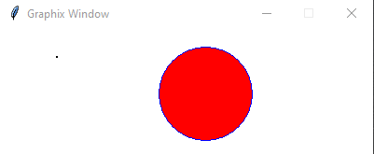
Summary of graphix
After running the code from the previous pages, the top part of our window will look like:

Slide 12
Object diagrams
In lecture 1 we illustrated the values of variables in a program using diagrams such as:
We can draw equivalent diagrams for variables of our graphical types (e.g. Point & Circle).
kilos
10.0
pounds
22.0

Slide 13
Object diagrams
For example, the value of the variable p after the statement:
>>> p = Point(10, 20)
is best illustrated as
The box represents an object of type Point.
The value of the variable p is a reference (arrow) to this Point object.
The object includes attributes x and y with values 10 and 20, respectively.
Point
p
x
10
y
20

Slide 14
Object diagrams
The following statement:
>>> c = Circle(Point(20, 30), 10)
results in a slightly more complex diagram:
The value of the variable c is a reference to a Circle object which contains a radius, and a centre that refers to a Point object.
Circle
Point
centre
x
20
c
radius
10
y
30

Slide 15
Object aliasing
The code:
>>> p1 = Point(10, 20)
>>> p2 = p1
results in the following, where two variables refer to the same object:
The object’s attributes can now be accessed or modified using either variable:
>>> p2.move(200, 0)
>>> p2.x
210
Point
p1
x
10
p2
y
20

